Slide 1

MTECH PROJECT
MASTERCARD PERSONAL EXPENSE MANAGEMENT SYSTEM – (MPEMS)
PHASE 1 PRESENTATION - TEAM S2

Slide 2
Presentation Overview
Session | Description | Approx. Duration
Presentation | Project Background & Team Introduction | 2 minutes
 | User Requirements Overview | 5 minutes
 | Project Risks | 6 minutes
 | Technical Challenges | 2 minutes
 | Overall Project Strategies (Management & Technical) | 3 minutes
 | Project Timeline and Estimates | 8 minutes
 | Project Progress | 2 minutes
 | Management Problems | 2 minutes
Q & A | Question and Answer | 15 minutes
Total |  | 45 minutes

Slide 3
Project Background
Project Customer
  MasterCard Singapore
Citibank
CreditCard
MERCHANT
( NIKE SHOP)
MERCHANT’S BANK
( OCBC)
MASTER
CARD
ISSUING
BANK
( CITIBANK )
System Objective
  Provide Personal Expense Management System for customers to track and manage their spending
Motivation
  Absence of consolidated view of all transactions
  Spenders getting more sophisticated
  Lack of CRM from existing payment network
  An opportunity to enhance customers experience with MasterCard
  Growing number of credit/debit card users and tech savvy user

Slide 4
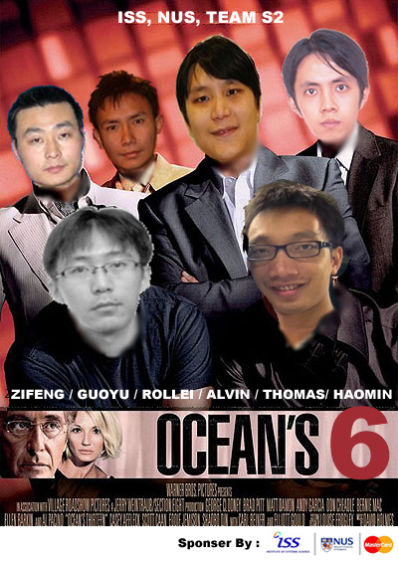
Project Team
ROLLEI
(Project Manager)
HAO MIN
(Implementation Manager)
ALVIN
(Quality Manager)
ZI FENG
(Test Manager)
THOMAS
(Business Analyst)
GUO YU
(Solution Architect)

Slide 5
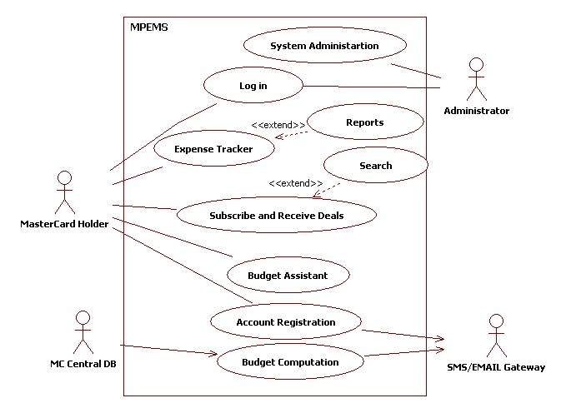
Requirements Overview

Slide 6
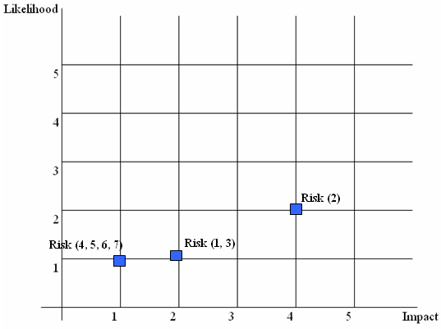
Project Risk
# | Risk | Impact, Likelihood
1 | Project client commitment to the project and availability | 4,2
2 | Team member departure and unavailability | 2,1
3 | Insufficient hardware server to act as central database and application environment | 2,1
4 | System portability risk | 1,1
5 | Dependency on third-party library and lack of experience in third-party library | 1,1
6 | Lack of experience in Responsive UI design for Mobile Website | 1,1
7 | Uncertain and Changing requirements | 1,1

Slide 7
Risk Technique - 1
# | Risk | Control Type | Techniques
1 | Team member departure and unavailability | Risk Transfer | Every project member will undertake a primary and secondary role. E.g. Team Member Alvin will have a primary role as a Quality Manager and Secondary role as a Project Manager. Alvin will have to take on the PM responsibility should the current PM leaves the team or took long offs from the project
 |  | Risk Avoidance | The man day estimated for each member should not exceed 70 days. This will help to ensure that the members will not be severely overloaded should there be a case where they need to take on leaving member’s teak.
 |  | Risk Minimization | Anticipate all oversea leaves, marriage plan, baby plan, relocation plan etc and factor these to schedule and effort planning
2 | Project client commitment to the project and availability | Risk Minimization | Continuously keep the project client updated with the project progress and future plans. Understand that the requirements will change over a long period and be open minded and flexible to these changes while ensuring that the change will not significantly affect the project schedule and effort
 |  | Risk Transfer | Request for a covering officer from project client. Keep the covering officer updated with the project progress and plans.
3 | Insufficient hardware server to act as central database and application environment | Risk Transfer | The server environment will be replicated and back up on a solution architect personal notebook. If the main server fail to work. Solution architect personal notebook will be activated immediately to avoid any delay due to the unavailability of server environment.

Slide 8
Risk Technique - 2
# | Risk | Control Type | Techniques
4 | System portability risk | Risk Minimization | Use known industry javascript package such as prototype, jquery
 |  | Risk Insurance | Shortlist 2 most widely used desktop browser and mobile browser. Design and test the system on the selected browsers. Inform project client that this is a limitation faced by all web application. Although it may not run on all browsers, it should run on the major browsers
5 | Dependency on third-party library and lack of experience in third-party library | Risk Minimization | Factored in the effort required by the solution architect to study third-party library.
 |  | Risk Minimization | Build and test the prototype using the third-party library.
6 | Lack of experience in Responsive UI design for Mobile Website | Risk Minimization | Factored in the effort required by the business analyst to study mobile website UI design.
 |  | Risk Minimization | Business analyst to create a UI specification. Build a prototype to test the UI usability. Analyze user’s feedback on prototype and incorporate the change when required.
7 | Uncertainty and Changing requirements | Risk Minimization | Build and walk through use case document and prototypes with client to ensure all essential functions have been accurately captured in functional specifications
 |  | Risk Minimization | Emplace proper change procedures to control changing requirements

Slide 9
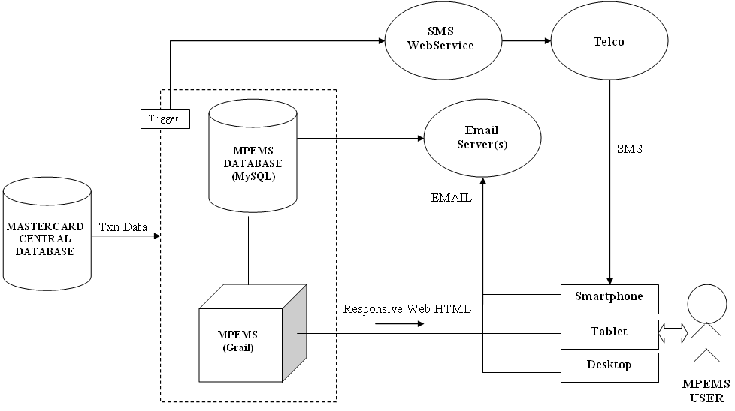
Technical Challenges
MPEMS High-level Architecture

Slide 10
Technical Challenges
Invoke call to SMS gateway when transaction records are refreshed
  SQL Triggers
  OS Services/ Background Agent
  Scheduled Job
  API

Slide 11
Technical Challenges
Responsive Web Design
  The Responsive Web Design is the practice to use fluid layouts and media queries to create designs able to adapt according to the user’s screen resolution.
  It allows to eliminate the need to create different designs (read templates) for each device (that in these days means desktop, netbook, tablet and mobile).
  Extracted from http://www.maurizioconventi.com/2012/02/08/responsive-web-design-with-twitter-bootstrap/ example : http://spigotdesign.com/
Challenges
  Relatively a new approach in UI Design (not a mature design methodology)
  Team member lack of experience

Slide 12
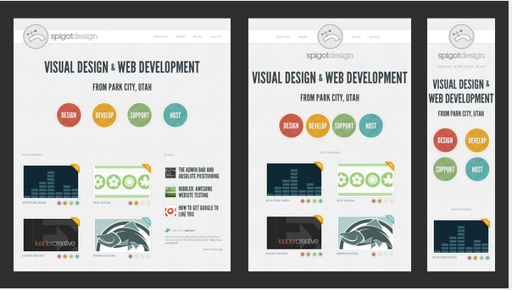
Technical Challenges
Example : e.g. http://spigotdesign.com/

Slide 13
Overall Project Strategies
(Technical & Management)
Technical
  Quality Planning
  Early and Detailed Prototype
  Capitalize on known packages to expedite development progress. E.g. grails and prototype

Slide 14
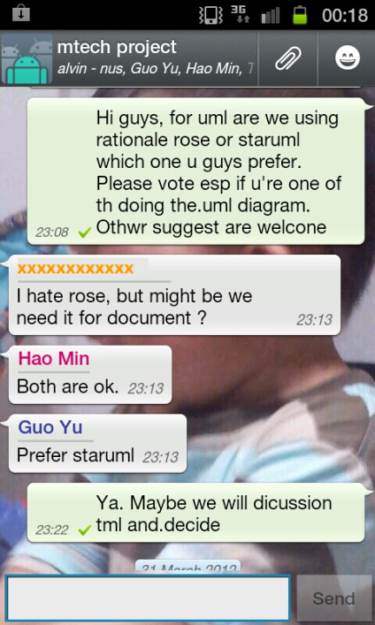
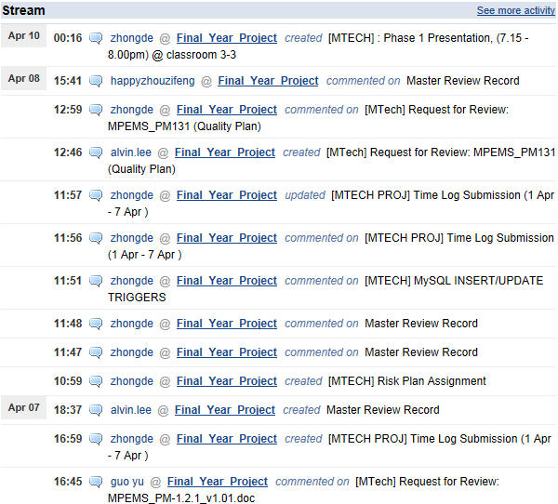
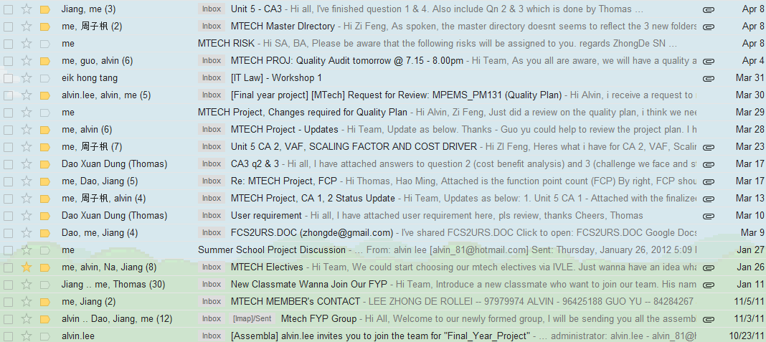
Overall Project Strategies
(Technical & Management)
Management
  Building a good relationship with our client (customer oriented)
  Active Risk Management
  Cultivate Team Excellence
  Always aim for win-win situation
  Active Communication

Slide 15
Overall Project Strategies
(Technical & Management)
Management
  Building a good relationship with our client (customer oriented)
  Active Risk Management
  Cultivate Team Excellence
  Always aim for win-win situation
  Active Communication

Slide 16
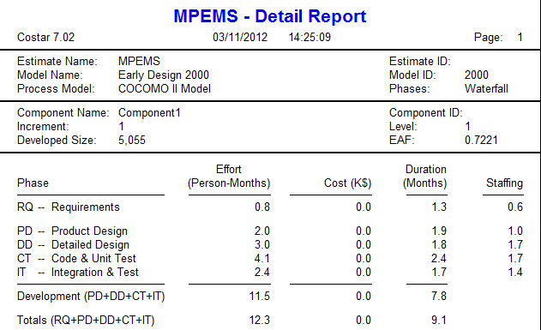
Project Effort Estimates - COCOMO
The estimated effort for the scope of this project based on COCOMO using Functional Point Count is 12.3 Person-Months which is equivalent to 374 man days.

Slide 17
Project Effort Estimates - WBS
The estimated effort for the scope of this project based on WBS and project team judgment is 369.5 Man days
Phase | # | Task Name | Estimates
Project Planning | 1 | Project Planning & Quality Planning | 24
 | 2 | Requirement Analysis | 14
 | 3 | First Quality Audit Meeting | 5
 | 4 | First Project Presentation | 4.5
Analysis and Design | 5 | Analysis Modeling | 66
 | 6 | High Level Design Modeling | 19
 | 7 | Prototype | 33.5
 | 8 | Second Quality Audit Meeting | 5
 | 9 | Second Project Presentation | 4.5
Implementation | 10 | Detailed Design Modeling | 27.5
 | 11 | Implementation | 56
 | 12 | System Testing | 37
 | 13 | User Acceptance Testing | 26.5
 | 14 | Project Closure | 27.5
 | 15 | Third Quality Audit Meeting | 5
 | 16 | Third Project Presentation | 14.5
Total Estimates |  |  | 369.5

Slide 18
Project High Level Timeline
Phase | # | Task Name | Start Date | Finish Date
Project Planning | 1 | Project Planning & Quality Planning | Fri 2/17/12 | Sun 4/1/12
 | 2 | Requirement Analysis | Sat 2/25/12 | Sun 4/1/12
 | 3 | First Quality Audit Meeting | Sat 3/31/12 | Tue 4/3/12
 | 4 | First Project Presentation | Sun 4/1/12 | Tue 4/10/12
Analysis and Design | 5 | Analysis Modeling | Wed 4/11/12 | Sat 8/11/12
 | 6 | High Level Design Modeling | Sun 5/27/12 | Sat 8/11/12
 | 7 | Prototype | Sun 7/8/12 | Sat 8/11/12
 | 8 | Second Quality Audit Meeting | Sat 8/11/12 | Tue 8/14/12
 | 9 | Second Project Presentation | Sun 8/12/12 | Tue 8/21/12
Implementation | 10 | Detailed Design Modeling | Wed 8/22/12 | Mon 9/10/12
 | 11 | Implementation | Sun 9/2/12 | Sun 9/23/12
 | 12 | System Testing | Sun 9/2/12 | Sun 10/14/12
 | 13 | User Acceptance Testing | Sun 10/14/12 | Sun 12/2/12
 | 14 | Project Closure | Mon 12/3/12 | Fri 1/4/13
 | 15 | Third Quality Audit Meeting | Sat 1/5/13 | Tue 1/8/13
 | 16 | Third Project Presentation | Wed 1/9/13 | Tue 1/15/13

Slide 19
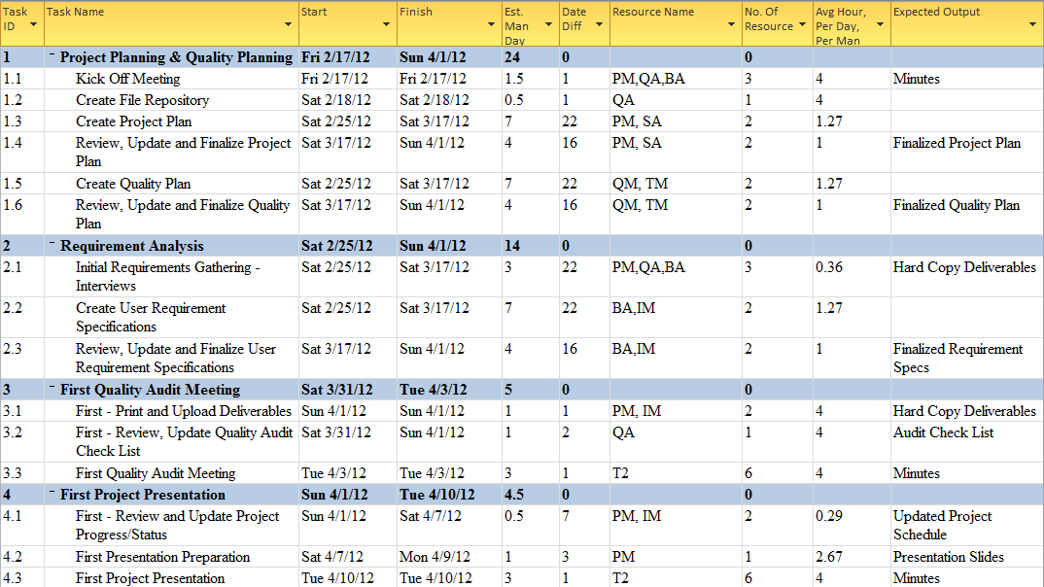
Project Timeline & Estimates ( Phase 1)

Slide 20
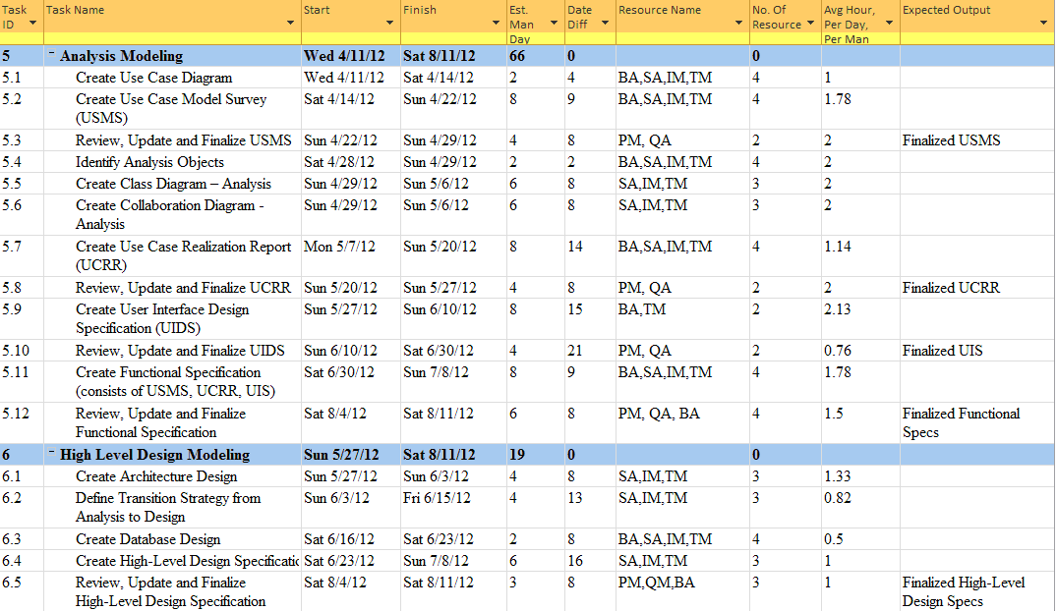
Project Timeline & Estimates ( Phase 2 , Part 1)

Slide 21
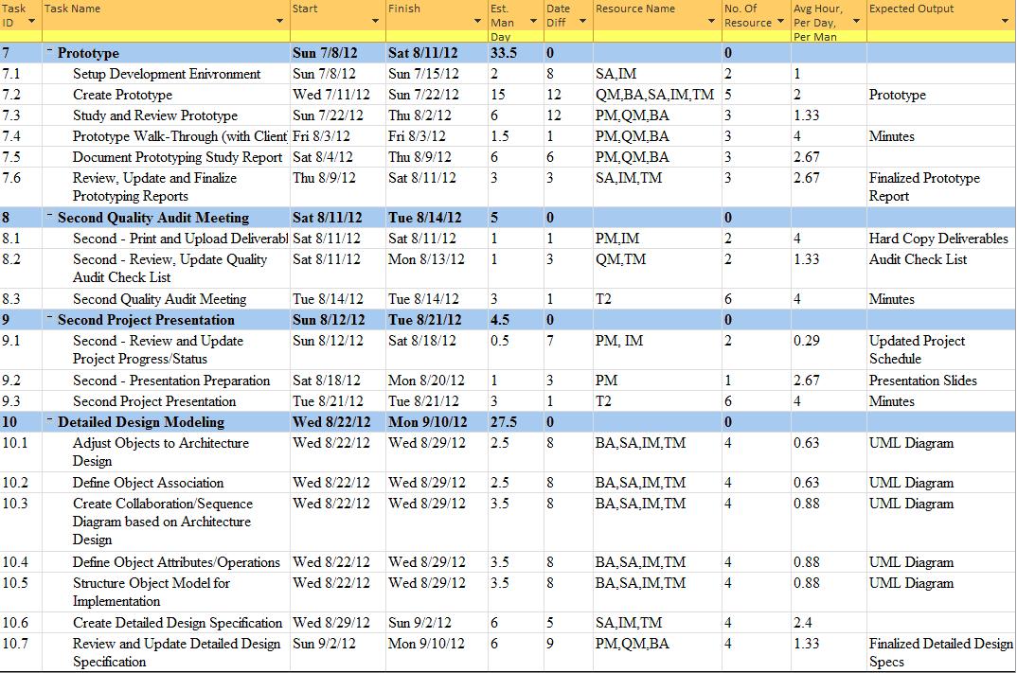
Project Timeline & Estimates ( Phase 2 , Part 2)…

Slide 22
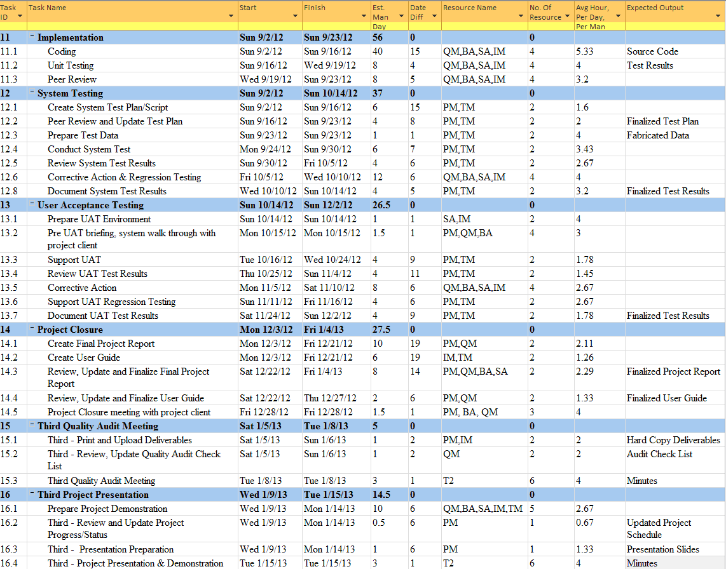
Project Timeline & Estimates ( Phase 3)

Slide 23
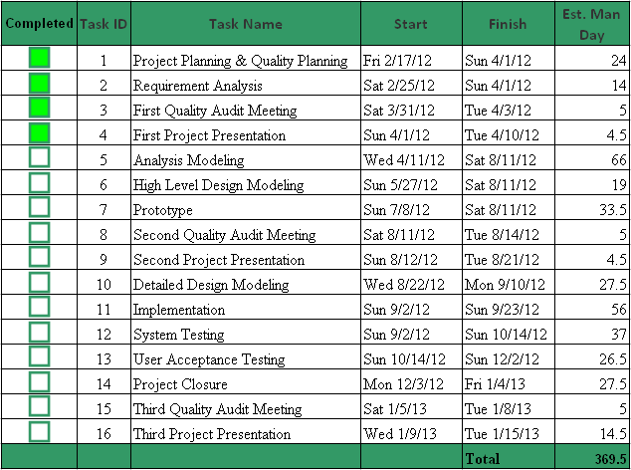
Project Progress

Slide 24
Management Challenges
Loss of Team Members
Lack of Requirements

